Slide 1
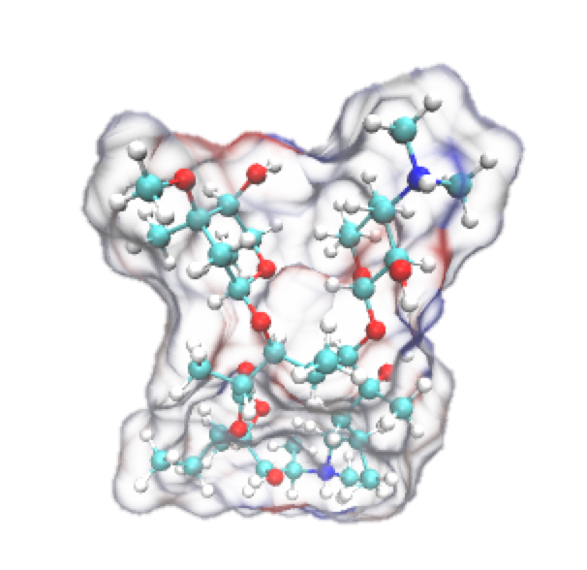
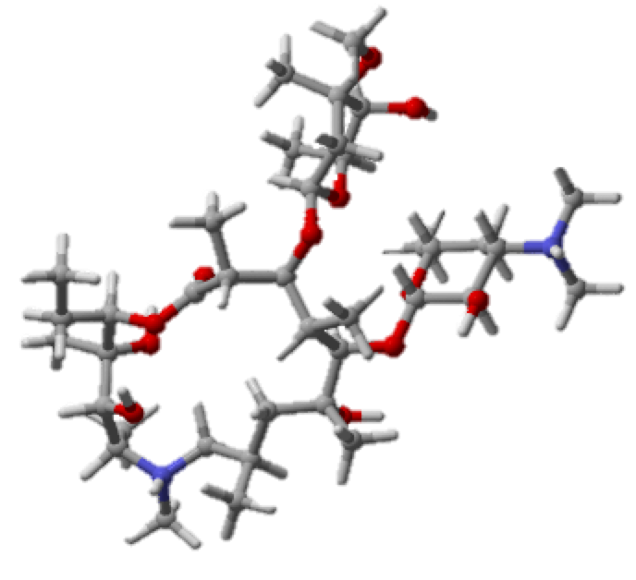
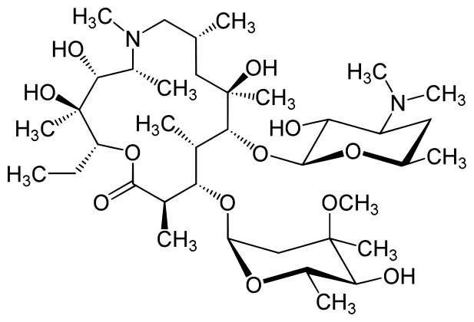
Cheminformatics of Antibiotics
Sarah Cooper

Slide 2
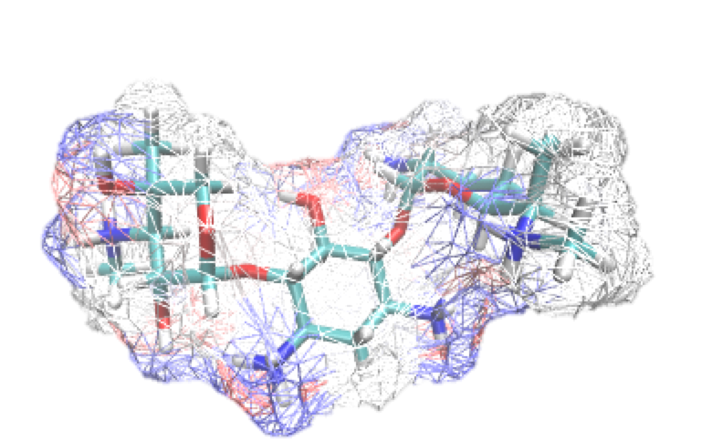
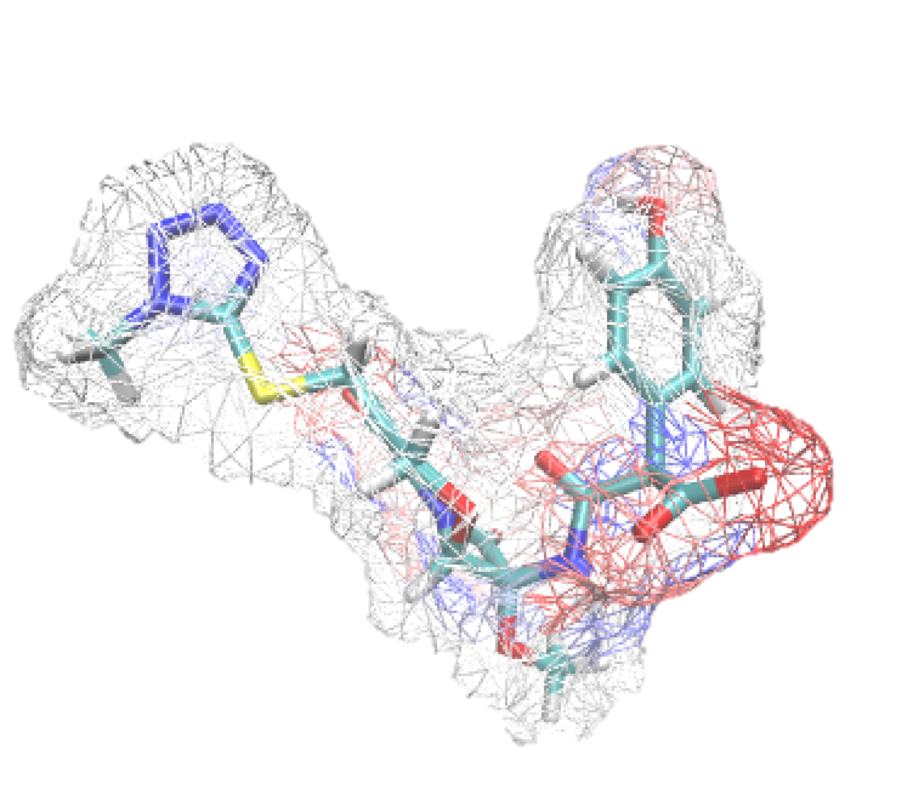
Cheminformatics
Using information about chemical compounds to generate quantitative structure activity relationships (QSAR)
2-D and 3-D structure
Charge
Hydrophobicity, hydrophilicity
Partition coefficient
Size
pKa
Etc.
Combines chemistry, computer science, and information science
Often used for computer aided drug design
Gentamycin (+5 charge)
Moxalactam (-2 charge)

Slide 3
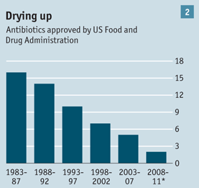
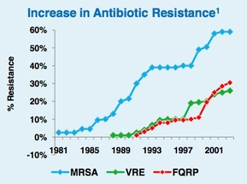
The War on Antibiotic Resistance
Antibiotics have been around since penicillin in the 1920’s
Bacteria are developing mechanisms against our treatment of infections at alarming rates

Slide 4
Goals
Use QSAR alongside molecular simulations to:
Understand why antibiotics permeate the membrane
Determine which characteristics are most crucial for effective permeability
Develop rules governing membrane permeability

Slide 5
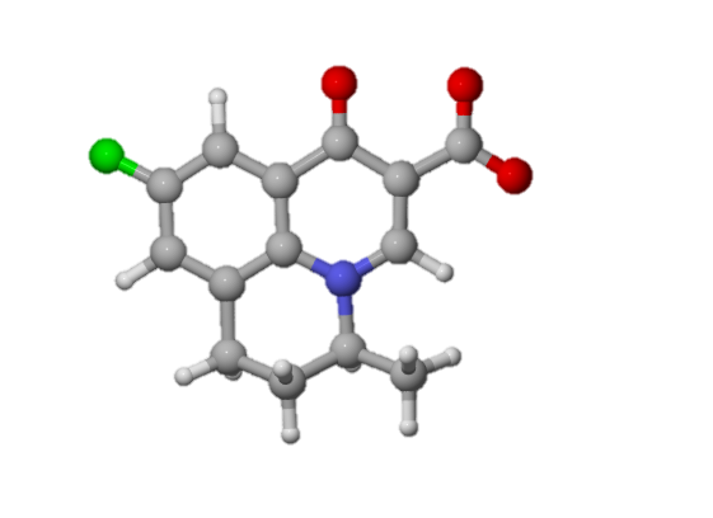

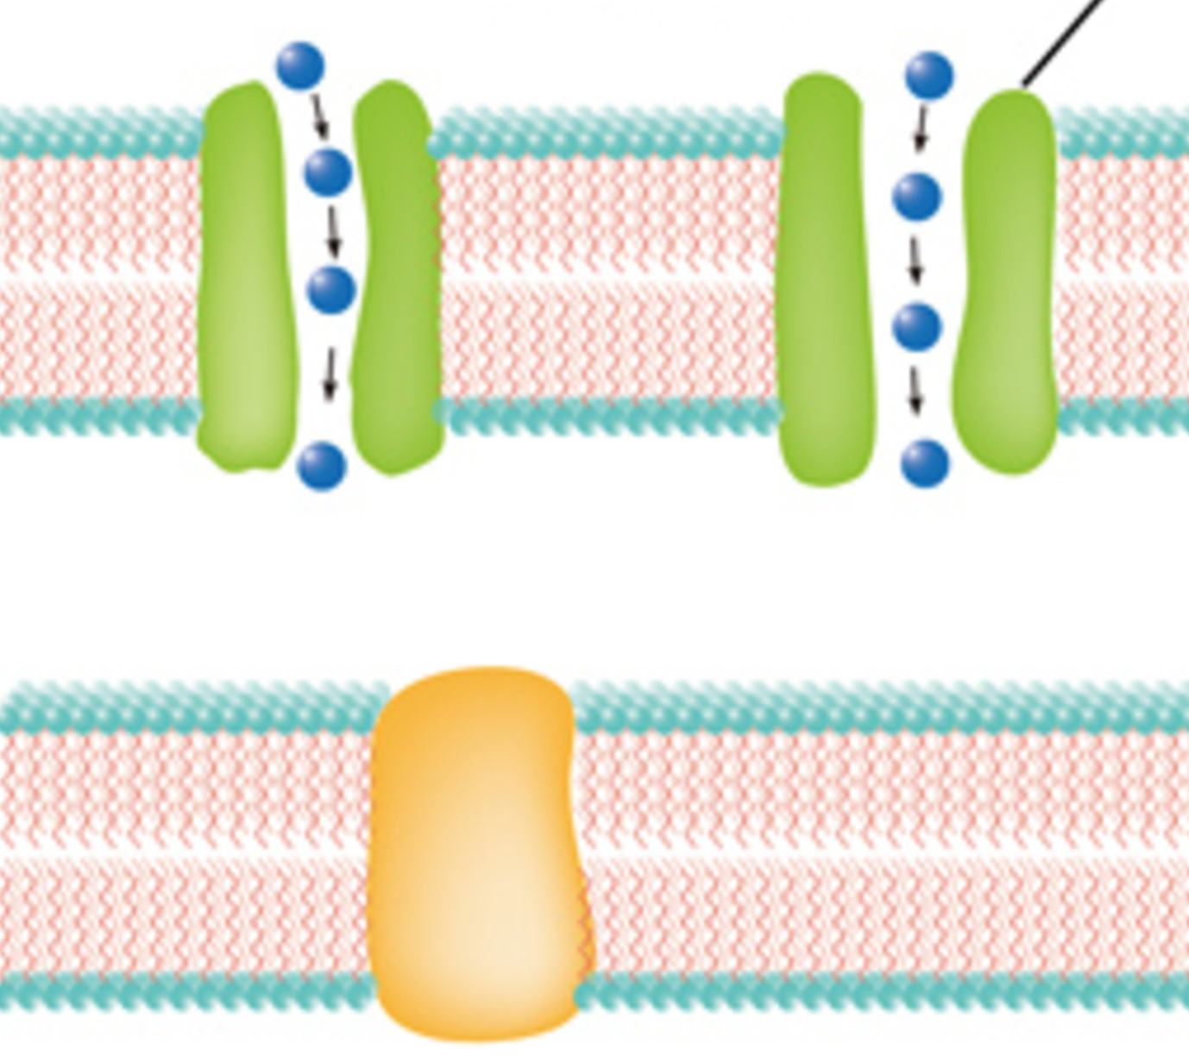
Membrane Permeability in Gram Negative Bacteria
You Shall not Pass!
Extracellular
?
?
Outer
Membrane
Periplasm
Inner
Membrane
Intracellular

Slide 6
Datasets
Original Test Set
20 Antibiotics of different:
Classes
Charges
Functional Groups
Sizes
Optimized with quantum mechanics
Extended Test Set
62 antibiotics used in E. coli.
44 antibiotics used in pseudomonas aeruginosa
Minimized in MOE
Calculated ~280 molecular descriptors
*structures are from the zinc database

Slide 7
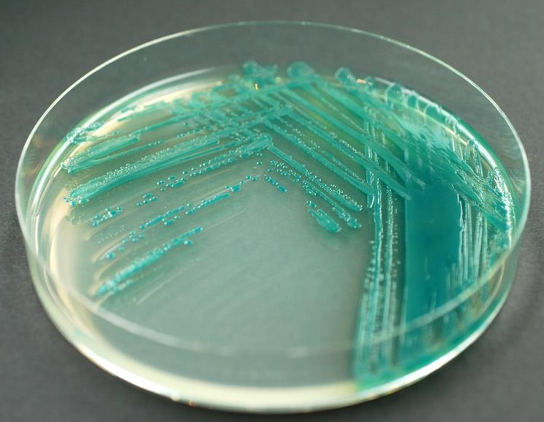
Experimental Data
Minimum Inhibitory Concentration (MIC)
Concentration of antibiotic needed to stop bacterial cell growth
E. coli
Wild type
Hyperporinated
TolC Efflux pump knockout
Transporter knockout
Outer membrane barrier
Pseudomonas aeruginosa
Wild type
Hyperporinated
3 efflux pump knockout
6 efflux pump knockout
Outer membrane barrier

Slide 8
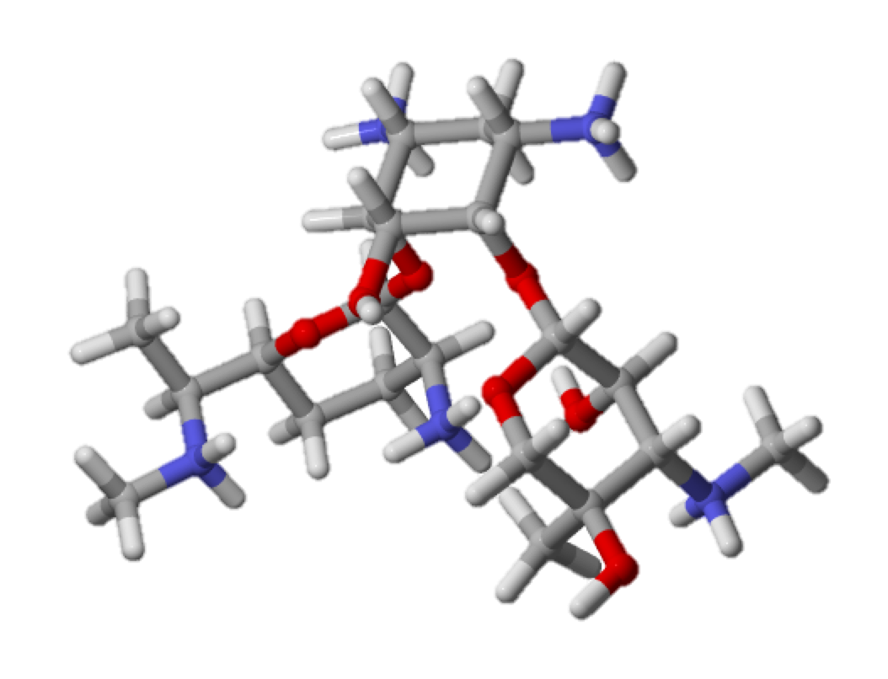
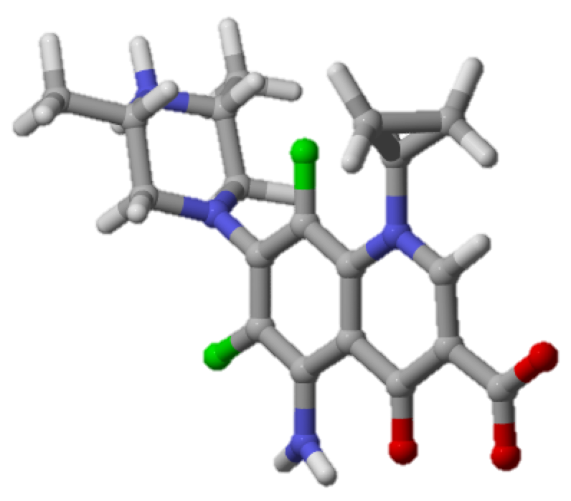
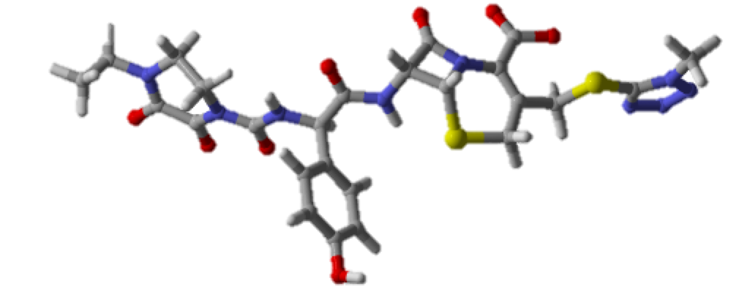
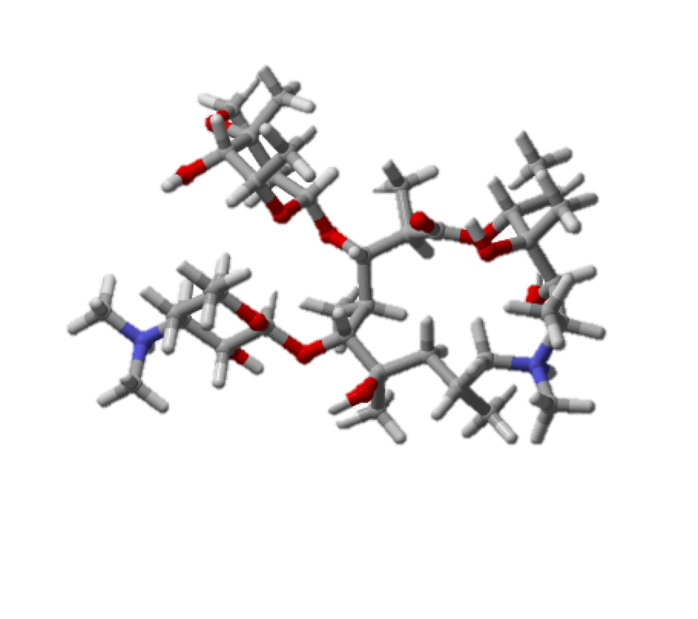
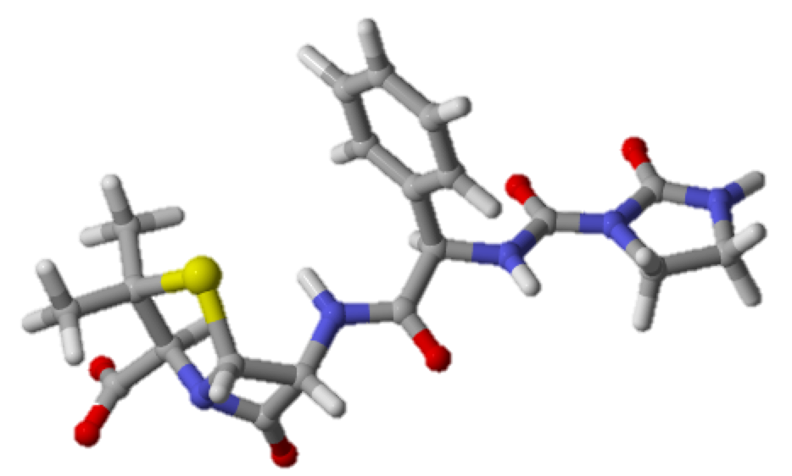
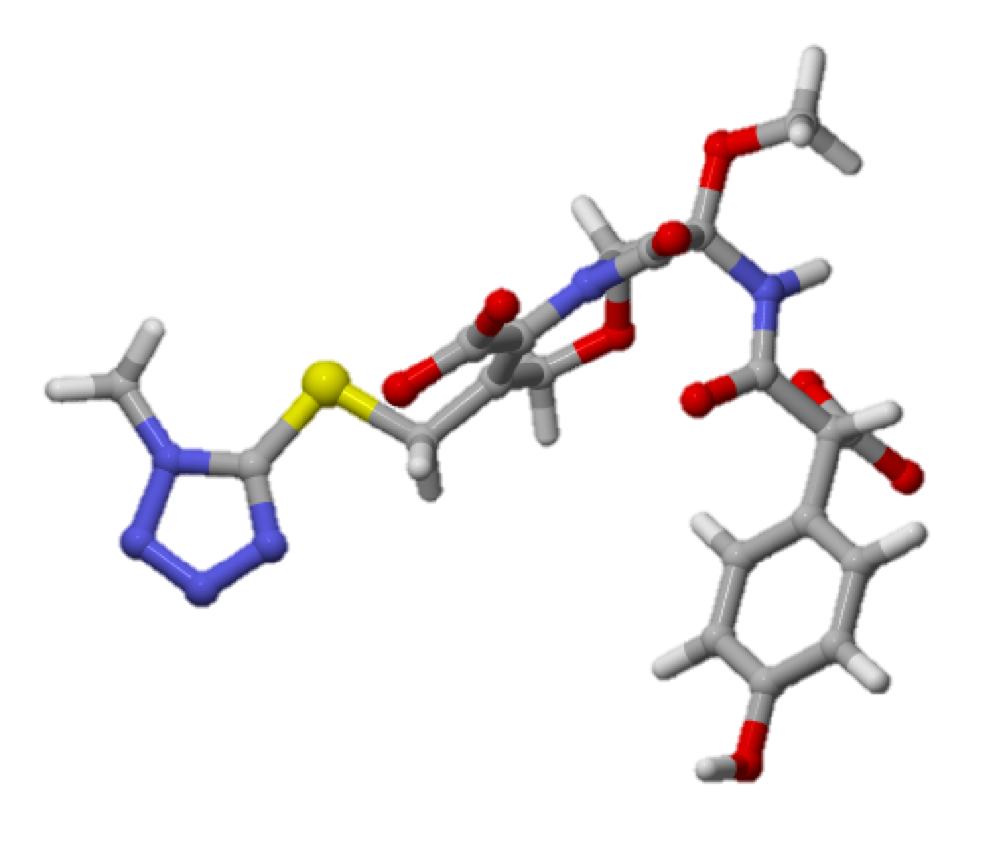
Example Structures
Aminoglyocides (Gentamycin)
Cephalosporins
(Cefoperazone)
Fluoroquinolones
(Sparfloxacin)
Macrolids
(Azythromycin)
Penicillins
(Azlocillin)
Oxacephems
(Moxalactam)
Notes:
Quinolones (flumequine)
Macrolids (azythromycin)
Penicillins (azlocillin)
Cephalosporins (cefoperazone)
Aminoglycoside (gentamycin)
Fluoroquinolones (sparfloxacin)

Slide 9

Get structures
Geometry optimization
With quantum mechanics
Calculate Descriptors in MOE
Minimization in MOE
Calculate descriptors in MOE
Group Antibiotics
By Charge
By Class
By Size, etc.
Correlate descriptors with MIC data
Correlate descriptors with MIC data
Group Antibiotics

Slide 10
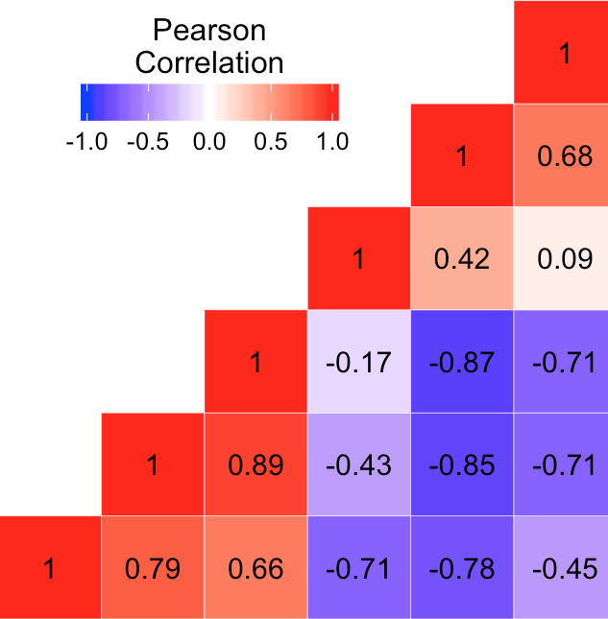
CORRELATION MATRIX
Used R to calculate correlation matrices
Outputs pearson R correlation value
-1 (negative correlation)
+1 (positive correlation)
Measures covariance

Slide 11

E. Coli Pseudomonas
Original 20 All Original 20 All
0.52 | 0.26 | 0.22 | 0.04 | 0.16 | 0.82 | -0.03 | 0.60 | 0.64
-0.11 | 0.09 | -0.18 | -0.09 | -0.14 | -0.16 | 0.05 | -0.08 | -0.09
-0.08 | -0.08 | -0.14 | -0.11 | -0.08 | -0.11 | 0.13 | -0.06 | -0.05
0.43 | 0.14 | 0.37 | 0.13 | 0.30 | 0.63 | -0.20 | 0.29 | 0.45
0.40 | 0.21 | 0.44 | 0.24 | 0.33 | 0.52 | -0.12 | 0.20 | 0.36
0.53 | 0.35 | 0.29 | 0.14 | 0.16 | 0.75 | -0.20 | 0.45 | 0.60
-0.25 | -0.14 | -0.03 | -0.07 | -0.02 | -0.46 | -0.07 | -0.47 | -0.41
-0.42 | -0.37 | -0.26 | -0.29 | -0.02 | -0.58 | -0.04 | -0.51 | -0.50
-0.06 | 0.05 | 0.05 | 0.48 | -0.28 | 0.08 | -0.02 | 0.13 | 0.04
0.52 | 0.28 | 0.21 | 0.07 | 0.11 | 0.82 | -0.01 | 0.63 | 0.65
0.54 | 0.42 | 0.43 | 0.24 | 0.27 | 0.68 | -0.11 | 0.38 | 0.53
0.54 | 0.38 | 0.34 | 0.18 | 0.20 | 0.75 | -0.17 | 0.44 | 0.59
0.50 | 0.20 | 0.22 | -0.01 | 0.23 | 0.78 | -0.05 | 0.52 | 0.60
0.50 | 0.20 | 0.06 | -0.13 | 0.05 | 0.83 | 0.15 | 0.76 | 0.68
0.47 | 0.21 | 0.23 | 0.07 | 0.20 | 0.76 | -0.05 | 0.52 | 0.58
-0.41 | -0.33 | -0.03 | -0.10 | 0.11 | -0.60 | -0.13 | -0.66 | -0.55
0.54 | 0.23 | 0.15 | -0.08 | 0.17 | 0.84 | 0.04 | 0.67 | 0.68
-0.31 | -0.42 | -0.49 | -0.40 | -0.29 | -0.26 | 0.56 | 0.16 | -0.12
0.50 | 0.31 | 0.19 | 0.11 | 0.05 | 0.80 | 0.02 | 0.66 | 0.64
-0.34 | -0.43 | -0.04 | 0.13 | 0.27 | -0.40 | -0.15 | -0.51 | -0.40
0.58 | 0.45 | 0.38 | 0.15 | 0.19 | 0.77 | -0.22 | 0.43 | 0.60
-0.06 | -0.03 | 0.30 | 0.11 | 0.21 | -0.14 | -0.32 | -0.46 | -0.22
0.30 | 0.43 | -0.01 | -0.06 | -0.25 | 0.48 | 0.07 | 0.50 | 0.43
-0.14 | 0.08 | 0.13 | 0.05 | 0.33 | -0.42 | -0.29 | -0.58 | -0.40
0.34 | 0.22 | 0.16 | 0.21 | -0.03 | 0.65 | 0.00 | 0.53 | 0.49
-0.31 | -0.05 | -0.08 | 0.19 | 0.08 | -0.55 | 0.09 | -0.45 | -0.46
0.38 | 0.28 | 0.47 | 0.47 | 0.33 | 0.37 | -0.04 | 0.18 | 0.28
-0.07 | 0.11 | 0.21 | 0.14 | 0.29 | -0.29 | -0.25 | -0.54 | -0.29
0.54 | 0.41 | 0.46 | 0.32 | 0.15 | 0.67 | -0.03 | 0.43 | 0.54
-0.29 | -0.28 | -0.17 | -0.14 | 0.07 | -0.48 | 0.21 | -0.31 | -0.39
0.30 | 0.13 | 0.17 | 0.09 | 0.27 | 0.25 | 0.40 | 0.28 | 0.28
-0.13 | 0.04 | 0.14 | 0.00 | 0.36 | -0.38 | -0.26 | -0.57 | -0.38
0.04 | -0.18 | -0.11 | -0.20 | -0.17 | 0.28 | -0.04 | 0.26 | 0.23
-0.44 | -0.26 | -0.28 | -0.16 | 0.07 | -0.69 | -0.07 | -0.62 | -0.59
0.35 | 0.22 | 0.51 | 0.38 | 0.55 | 0.22 | 0.01 | 0.00 | 0.15
0.51 | 0.26 | 0.20 | 0.05 | 0.12 | 0.82 | -0.04 | 0.62 | 0.64
0.22 | 0.22 | 0.37 | 0.28 | 0.24 | 0.29 | -0.33 | -0.12 | 0.15
0.00 | 0.26 | 0.34 | 0.37 | 0.11 | -0.09 | -0.37 | -0.42 | -0.15
-0.42 | -0.37 | -0.26 | -0.29 | -0.02 | -0.58 | -0.04 | -0.51 | -0.50
0.52 | 0.27 | 0.20 | 0.07 | 0.12 | 0.81 | 0.00 | 0.63 | 0.64
-0.12 | -0.27 | 0.05 | -0.23 | 0.42 | -0.25 | -0.17 | -0.46 | -0.26
0.48 | 0.16 | 0.21 | -0.02 | 0.25 | 0.75 | -0.04 | 0.50 | 0.57
0.31 | 0.50 | 0.43 | 0.39 | 0.04 | 0.33 | -0.22 | 0.09 | 0.24
0.19 | 0.19 | 0.42 | 0.28 | 0.36 | 0.19 | -0.36 | -0.23 | 0.06
0.01 | 0.23 | 0.38 | 0.34 | 0.23 | -0.12 | -0.37 | -0.45 | -0.18
0.52 | 0.30 | 0.21 | 0.10 | 0.09 | 0.81 | 0.01 | 0.65 | 0.65
0.52 | 0.24 | 0.23 | 0.00 | 0.22 | 0.80 | -0.05 | 0.54 | 0.62
0.52 | 0.24 | 0.23 | 0.01 | 0.19 | 0.81 | -0.05 | 0.56 | 0.62
0.55 | 0.26 | 0.14 | -0.07 | 0.13 | 0.86 | 0.04 | 0.70 | 0.69
0.55 | 0.24 | 0.14 | -0.09 | 0.15 | 0.86 | 0.03 | 0.69 | 0.69
0.49 | 0.18 | 0.22 | -0.01 | 0.24 | 0.76 | -0.06 | 0.50 | 0.58
0.50 | 0.21 | 0.24 | 0.03 | 0.21 | 0.78 | -0.06 | 0.52 | 0.59
0.59 | 0.33 | 0.14 | -0.05 | 0.10 | 0.86 | 0.15 | 0.76 | 0.73
0.59 | 0.31 | 0.13 | -0.10 | 0.13 | 0.85 | 0.16 | 0.75 | 0.72
0.59 | 0.48 | 0.35 | 0.29 | 0.09 | 0.79 | -0.03 | 0.59 | 0.64
0.59 | 0.48 | 0.35 | 0.29 | 0.09 | 0.79 | -0.03 | 0.59 | 0.64
-0.27 | -0.17 | 0.07 | -0.04 | 0.10 | -0.46 | -0.13 | -0.56 | -0.43
-0.26 | -0.13 | 0.11 | 0.00 | 0.11 | -0.45 | -0.17 | -0.59 | -0.42
0.08 | -0.01 | 0.20 | 0.17 | 0.25 | 0.19 | -0.33 | -0.13 | 0.07
0.19 | 0.04 | -0.06 | 0.08 | -0.21 | 0.48 | 0.29 | 0.57 | 0.43
-0.12 | -0.28 | -0.11 | -0.24 | -0.04 | -0.14 | 0.52 | 0.02 | -0.04
-0.12 | -0.01 | -0.10 | 0.37 | -0.32 | 0.03 | -0.03 | 0.15 | 0.04
0.16 | 0.12 | -0.07 | 0.18 | -0.28 | 0.45 | 0.16 | 0.54 | 0.40
0.21 | 0.34 | 0.32 | 0.28 | 0.06 | 0.23 | 0.14 | 0.28 | 0.19
0.10 | -0.13 | -0.20 | -0.72 | 0.17 | 0.19 | 0.09 | 0.17 | 0.15
-0.02 | -0.29 | -0.05 | -0.22 | 0.21 | -0.10 | 0.18 | -0.08 | -0.06
0.42 | 0.23 | 0.09 | 0.00 | -0.03 | 0.67 | 0.23 | 0.65 | 0.58
0.43 | 0.10 | 0.23 | -0.09 | 0.31 | 0.67 | -0.06 | 0.41 | 0.48
0.45 | 0.23 | -0.01 | -0.17 | -0.09 | 0.77 | 0.33 | 0.78 | 0.67
0.06 | 0.09 | 0.05 | 0.39 | -0.21 | 0.24 | 0.01 | 0.29 | 0.20
-0.09 | 0.13 | 0.27 | 0.19 | 0.24 | -0.25 | -0.14 | -0.46 | -0.27
0.32 | 0.19 | 0.12 | 0.23 | 0.06 | 0.52 | 0.11 | 0.52 | 0.45
-0.21 | 0.02 | 0.11 | 0.45 | 0.05 | -0.42 | 0.14 | -0.39 | -0.31
0.47 | 0.25 | 0.15 | 0.10 | 0.02 | 0.74 | 0.10 | 0.68 | 0.62
0.01 | -0.02 | -0.03 | 0.00 | 0.05 | 0.07 | -0.01 | 0.13 | 0.18
0.03 | 0.05 | 0.01 | 0.11 | 0.06 | 0.04 | -0.06 | -0.02 | 0.05
-0.01 | -0.15 | -0.10 | -0.20 | 0.05 | 0.01 | 0.13 | 0.20 | 0.20
-0.11 | -0.07 | -0.07 | -0.10 | -0.06 | -0.05 | -0.04 | -0.07 | -0.08
-0.09 | -0.06 | -0.06 | -0.08 | -0.04 | -0.04 | -0.03 | -0.06 | -0.06
-0.03 | 0.04 | 0.04 | 0.13 | -0.01 | -0.01 | -0.17 | -0.13 | -0.06
0.15 | 0.14 | 0.11 | 0.22 | 0.06 | 0.05 | -0.06 | -0.05 | 0.00
0.03 | 0.06 | 0.10 | 0.08 | 0.00 | 0.05 | -0.11 | -0.03 | 0.04
-0.01 | 0.10 | 0.01 | 0.24 | -0.05 | -0.08 | -0.06 | -0.18 | -0.18
0.17 | 0.02 | 0.06 | 0.06 | -0.32 | -0.37 | 0.26 | 0.15 | 0.04
-0.21 | -0.10 | -0.13 | -0.04 | 0.00 | 0.07 | -0.14 | -0.09 | -0.11
-0.03 | -0.05 | -0.05 | -0.04 | 0.07 | 0.10 | -0.04 | 0.13 | 0.18
0.07 | 0.15 | 0.14 | 0.24 | 0.03 | 0.06 | -0.10 | -0.02 | 0.04
0.05 | 0.10 | 0.12 | 0.14 | 0.01 | 0.05 | -0.12 | -0.03 | 0.04
0.00 | 0.00 | -0.02 | 0.04 | 0.01 | 0.00 | -0.01 | 0.08 | 0.12
-0.05 | -0.16 | -0.15 | -0.15 | -0.02 | 0.01 | 0.10 | 0.26 | 0.28
-0.01 | 0.02 | -0.01 | 0.05 | 0.05 | 0.06 | -0.03 | 0.07 | 0.11
0.08 | 0.21 | 0.14 | 0.24 | -0.11 | -0.13 | 0.05 | -0.16 | -0.23
-0.02 | -0.12 | -0.12 | -0.10 | 0.03 | 0.03 | 0.05 | 0.22 | 0.27
0.33 | 0.01 | -0.06 | -0.08 | -0.03 | -0.05 | 0.79 | 0.52 | 0.35
-0.29 | -0.19 | -0.17 | -0.25 | -0.14 | -0.12 | -0.03 | 0.00 | -0.04
-0.04 | -0.08 | -0.06 | -0.09 | 0.09 | 0.14 | -0.05 | 0.14 | 0.20
-0.03 | 0.25 | 0.22 | 0.22 | -0.04 | -0.06 | -0.15 | -0.23 | -0.27
0.01 | -0.03 | -0.06 | 0.08 | 0.05 | 0.05 | -0.08 | -0.01 | 0.08
0.16 | 0.27 | 0.22 | 0.32 | 0.01 | 0.01 | -0.09 | -0.20 | -0.17
-0.12 | -0.11 | -0.10 | -0.16 | 0.03 | 0.13 | -0.08 | 0.04 | 0.08
0.28 | 0.10 | 0.13 | 0.08 | 0.01 | -0.09 | 0.13 | 0.00 | -0.03
0.07 | -0.01 | -0.01 | -0.09 | 0.19 | 0.22 | 0.06 | 0.19 | 0.22
0.01 | 0.04 | 0.03 | 0.17 | -0.08 | -0.09 | 0.05 | -0.01 | -0.02
0.33 | 0.08 | 0.08 | -0.01 | 0.24 | 0.19 | 0.16 | 0.22 | 0.19
0.26 | 0.19 | 0.16 | 0.24 | -0.08 | -0.16 | 0.13 | 0.03 | 0.07
0.23 | -0.04 | 0.03 | -0.13 | 0.14 | 0.08 | 0.25 | 0.26 | 0.26
-0.02 | -0.12 | -0.09 | -0.11 | -0.14 | -0.19 | 0.19 | 0.16 | 0.09
0.26 | 0.04 | 0.04 | -0.08 | 0.22 | 0.16 | 0.21 | 0.31 | 0.28
0.24 | 0.12 | 0.15 | 0.15 | -0.02 | -0.10 | 0.10 | -0.04 | -0.04
0.01 | 0.07 | 0.03 | -0.09 | 0.10 | 0.13 | -0.02 | -0.01 | -0.02
0.11 | 0.15 | 0.06 | 0.28 | -0.20 | -0.21 | 0.04 | -0.08 | -0.15
0.45 | 0.13 | 0.16 | 0.05 | 0.25 | 0.16 | 0.23 | 0.24 | 0.22
-0.02 | -0.03 | -0.04 | -0.02 | 0.09 | 0.12 | -0.08 | 0.09 | 0.15
0.03 | 0.13 | 0.10 | 0.23 | 0.09 | 0.06 | -0.19 | -0.26 | -0.17
0.06 | 0.16 | 0.13 | 0.26 | 0.13 | 0.12 | -0.23 | -0.35 | -0.26
0.18 | 0.02 | 0.06 | 0.05 | -0.31 | -0.36 | 0.26 | 0.15 | 0.05
-0.03 | -0.05 | -0.06 | -0.04 | 0.06 | 0.09 | -0.03 | 0.13 | 0.19
-0.07 | 0.14 | 0.03 | 0.21 | 0.07 | 0.00 | -0.18 | -0.30 | -0.24
0.00 | 0.00 | -0.03 | 0.04 | 0.00 | -0.01 | 0.01 | 0.09 | 0.13
0.21 | 0.02 | 0.02 | -0.07 | 0.17 | 0.13 | 0.09 | 0.12 | 0.16
0.07 | 0.14 | 0.11 | 0.23 | 0.07 | 0.01 | -0.16 | -0.24 | -0.17
0.10 | 0.16 | 0.14 | 0.25 | 0.09 | 0.05 | -0.18 | -0.30 | -0.24
-0.05 | -0.06 | -0.06 | -0.07 | 0.10 | 0.15 | -0.06 | 0.12 | 0.18
0.00 | 0.00 | -0.02 | 0.04 | 0.02 | 0.02 | -0.01 | 0.08 | 0.13
0.05 | 0.03 | 0.00 | 0.04 | 0.05 | 0.06 | 0.02 | 0.12 | 0.16
0.00 | -0.10 | -0.10 | -0.12 | 0.07 | 0.09 | 0.04 | 0.22 | 0.27
0.00 | -0.11 | -0.11 | -0.11 | 0.05 | 0.06 | 0.05 | 0.22 | 0.27
-0.01 | 0.01 | -0.03 | 0.05 | -0.01 | -0.01 | -0.02 | 0.06 | 0.11
0.03 | 0.05 | 0.01 | 0.09 | 0.04 | 0.05 | -0.01 | 0.07 | 0.13
-0.01 | -0.18 | -0.15 | -0.18 | 0.04 | 0.06 | 0.12 | 0.32 | 0.37
-0.01 | -0.21 | -0.17 | -0.18 | -0.01 | -0.01 | 0.15 | 0.33 | 0.38
0.06 | -0.02 | 0.02 | -0.01 | 0.16 | 0.22 | -0.01 | 0.15 | 0.22
0.06 | -0.02 | 0.02 | -0.01 | 0.16 | 0.22 | -0.01 | 0.15 | 0.22
0.05 | 0.16 | 0.09 | 0.22 | -0.15 | -0.17 | 0.06 | -0.14 | -0.18
0.10 | 0.20 | 0.13 | 0.24 | -0.11 | -0.12 | 0.05 | -0.14 | -0.18
-0.06 | 0.05 | 0.06 | 0.20 | -0.05 | -0.07 | -0.12 | -0.18 | -0.15
-0.13 | 0.04 | 0.04 | 0.05 | -0.04 | 0.06 | -0.15 | -0.07 | -0.12
0.01 | 0.16 | 0.08 | 0.20 | -0.09 | -0.06 | -0.04 | -0.07 | -0.17
-0.15 | -0.07 | -0.01 | -0.14 | -0.02 | 0.06 | -0.14 | -0.09 | -0.13
-0.20 | -0.04 | 0.01 | -0.06 | -0.06 | 0.05 | -0.18 | -0.07 | -0.09
-0.21 | -0.03 | -0.05 | 0.03 | 0.66 | 0.75 | -0.16 | -0.16 | 0.01
0.19 | 0.07 | 0.09 | 0.02 | 0.08 | 0.07 | 0.13 | 0.17 | 0.17
0.17 | 0.27 | 0.15 | 0.27 | -0.06 | -0.08 | 0.03 | -0.05 | -0.09
-0.02 | 0.18 | 0.13 | 0.24 | -0.02 | 0.07 | -0.12 | -0.08 | -0.06
Correlation Matrix Values
-1.00
-0.80
-0.60
-0.40
-0.20
0.00
0.20
0.40
0.60
0.80
1.00
0.62 | -0.16 | 0.16 | -0.10 | 0.09 | -0.03 | 0.87 | 0.75 | 0.76 | 0.40 | -0.24 | 0.10 | 0.48 | 0.19 | 0.73
0.18 | 0.57 | -0.05 | 0.13 | -0.10 | -0.09 | -0.19 | -0.15 | -0.16 | 0.15 | -0.05 | 0.02 | 0.06 | 0.38 | -0.03
0.37 | 0.83 | 0.01 | 0.27 | -0.06 | -0.07 | -0.13 | -0.12 | -0.08 | 0.22 | 0.02 | 0.12 | 0.04 | 0.65 | 0.04
0.50 | -0.21 | 0.28 | 0.10 | 0.25 | 0.22 | 0.77 | 0.62 | 0.69 | 0.30 | -0.35 | 0.07 | 0.22 | -0.07 | 0.50
0.36 | -0.29 | 0.27 | 0.11 | 0.27 | 0.26 | 0.69 | 0.52 | 0.60 | 0.26 | -0.33 | 0.07 | 0.14 | -0.22 | 0.39
0.66 | 0.04 | 0.43 | 0.14 | 0.37 | 0.21 | 0.81 | 0.74 | 0.71 | 0.33 | -0.41 | 0.01 | 0.34 | 0.05 | 0.57
-0.39 | 0.19 | 0.38 | 0.16 | 0.46 | 0.16 | -0.48 | -0.33 | -0.34 | -0.50 | -0.01 | -0.11 | -0.50 | -0.33 | -0.54
-0.44 | 0.13 | 0.29 | 0.14 | 0.36 | 0.15 | -0.46 | -0.37 | -0.37 | -0.65 | 0.01 | -0.12 | -0.53 | -0.34 | -0.54
0.00 | -0.42 | -0.29 | -0.57 | -0.31 | -0.42 | 0.18 | 0.25 | 0.08 | 0.23 | 0.28 | -0.15 | 0.53 | 0.27 | 0.51
0.64 | -0.16 | 0.14 | -0.15 | 0.06 | -0.08 | 0.87 | 0.78 | 0.77 | 0.43 | -0.20 | 0.09 | 0.55 | 0.25 | 0.77
0.63 | -0.06 | 0.21 | 0.06 | 0.16 | 0.13 | 0.81 | 0.65 | 0.68 | 0.47 | -0.41 | 0.02 | 0.39 | 0.07 | 0.59
0.67 | 0.01 | 0.37 | 0.12 | 0.31 | 0.19 | 0.83 | 0.73 | 0.72 | 0.39 | -0.42 | 0.01 | 0.36 | 0.06 | 0.59
0.55 | -0.14 | 0.27 | 0.00 | 0.22 | 0.08 | 0.82 | 0.69 | 0.72 | 0.28 | -0.29 | 0.09 | 0.33 | 0.06 | 0.60
0.57 | -0.20 | 0.00 | -0.30 | -0.08 | -0.25 | 0.79 | 0.74 | 0.70 | 0.36 | -0.01 | 0.10 | 0.60 | 0.36 | 0.78
0.54 | -0.20 | 0.20 | -0.04 | 0.15 | 0.05 | 0.83 | 0.69 | 0.72 | 0.34 | -0.27 | 0.09 | 0.39 | 0.08 | 0.64
-0.49 | 0.03 | 0.15 | 0.48 | 0.25 | 0.52 | -0.50 | -0.59 | -0.52 | -0.38 | -0.12 | -0.11 | -0.69 | -0.54 | -0.68
0.62 | -0.14 | 0.15 | -0.16 | 0.08 | -0.12 | 0.85 | 0.77 | 0.78 | 0.34 | -0.17 | 0.13 | 0.50 | 0.25 | 0.74
-0.36 | -0.04 | -0.27 | -0.26 | -0.26 | -0.29 | -0.48 | -0.28 | -0.43 | -0.36 | 0.69 | -0.02 | 0.01 | 0.21 | -0.21
0.66 | -0.16 | 0.05 | -0.23 | -0.03 | -0.17 | 0.84 | 0.78 | 0.75 | 0.50 | -0.14 | 0.09 | 0.65 | 0.34 | 0.82
-0.35 | -0.20 | 0.17 | 0.24 | 0.25 | 0.35 | -0.11 | -0.29 | -0.16 | -0.26 | -0.23 | -0.05 | -0.47 | -0.52 | -0.34
0.70 | 0.04 | 0.43 | 0.15 | 0.37 | 0.21 | 0.84 | 0.79 | 0.77 | 0.35 | -0.42 | 0.05 | 0.36 | 0.06 | 0.59
-0.12 | -0.09 | 0.09 | 0.47 | 0.14 | 0.54 | 0.10 | -0.22 | -0.11 | 0.05 | -0.48 | -0.09 | -0.47 | -0.47 | -0.25
0.46 | 0.15 | -0.07 | -0.13 | -0.15 | -0.16 | 0.29 | 0.40 | 0.24 | 0.37 | 0.02 | -0.04 | 0.57 | 0.43 | 0.46
-0.21 | 0.22 | 0.07 | 0.34 | 0.12 | 0.23 | -0.34 | -0.46 | -0.19 | -0.16 | -0.39 | 0.11 | -0.45 | -0.29 | -0.45
0.52 | -0.27 | -0.07 | -0.19 | -0.13 | -0.10 | 0.72 | 0.63 | 0.61 | 0.58 | -0.08 | 0.07 | 0.62 | 0.28 | 0.77
-0.33 | 0.09 | -0.27 | -0.04 | -0.23 | -0.14 | -0.50 | -0.51 | -0.34 | -0.15 | 0.03 | 0.05 | -0.19 | 0.02 | -0.29
0.27 | -0.29 | 0.14 | -0.21 | 0.13 | -0.13 | 0.51 | 0.45 | 0.61 | 0.30 | -0.14 | 0.22 | 0.25 | -0.07 | 0.39
0.10 | 0.46 | 0.20 | 0.51 | 0.21 | 0.34 | -0.07 | -0.26 | -0.04 | 0.08 | -0.46 | 0.11 | -0.36 | -0.08 | -0.25
0.53 | -0.19 | -0.12 | -0.16 | -0.20 | -0.14 | 0.77 | 0.56 | 0.60 | 0.56 | -0.20 | 0.12 | 0.45 | 0.24 | 0.61
-0.32 | 0.16 | -0.39 | -0.13 | -0.37 | -0.31 | -0.54 | -0.55 | -0.39 | -0.25 | 0.25 | 0.08 | -0.19 | 0.24 | -0.30
0.20 | -0.14 | -0.21 | -0.22 | -0.24 | -0.27 | 0.34 | 0.20 | 0.35 | 0.33 | 0.07 | 0.26 | 0.17 | 0.16 | 0.30
-0.15 | 0.26 | 0.04 | 0.47 | 0.08 | 0.35 | -0.27 | -0.48 | -0.19 | -0.11 | -0.42 | 0.11 | -0.50 | -0.26 | -0.43
0.00 | -0.36 | -0.12 | 0.09 | -0.12 | 0.24 | 0.27 | 0.13 | -0.02 | 0.22 | 0.08 | -0.10 | 0.02 | -0.16 | 0.11
-0.44 | 0.23 | -0.05 | 0.22 | 0.02 | 0.12 | -0.68 | -0.66 | -0.52 | -0.36 | -0.03 | -0.01 | -0.49 | -0.17 | -0.58
0.18 | -0.24 | 0.00 | 0.00 | 0.01 | 0.01 | 0.41 | 0.19 | 0.51 | 0.26 | -0.21 | 0.33 | 0.01 | -0.11 | 0.21
0.64 | -0.17 | 0.11 | -0.13 | 0.04 | -0.06 | 0.86 | 0.76 | 0.76 | 0.46 | -0.21 | 0.10 | 0.55 | 0.24 | 0.77
0.20 | -0.12 | 0.39 | 0.23 | 0.40 | 0.35 | 0.46 | 0.31 | 0.38 | 0.09 | -0.59 | -0.06 | -0.07 | -0.36 | 0.13
-0.10 | -0.15 | 0.26 | 0.23 | 0.31 | 0.38 | 0.08 | -0.02 | 0.03 | 0.02 | -0.59 | -0.15 | -0.21 | -0.53 | -0.17
-0.44 | 0.13 | 0.29 | 0.14 | 0.36 | 0.15 | -0.46 | -0.37 | -0.37 | -0.65 | 0.01 | -0.12 | -0.53 | -0.34 | -0.54
0.63 | -0.16 | 0.14 | -0.15 | 0.07 | -0.08 | 0.86 | 0.77 | 0.77 | 0.42 | -0.20 | 0.09 | 0.54 | 0.24 | 0.76
-0.27 | -0.04 | 0.13 | 0.48 | 0.20 | 0.48 | -0.09 | -0.36 | -0.13 | -0.25 | -0.35 | 0.10 | -0.66 | -0.53 | -0.48
0.51 | -0.15 | 0.27 | 0.00 | 0.22 | 0.07 | 0.79 | 0.66 | 0.70 | 0.24 | -0.27 | 0.09 | 0.29 | 0.04 | 0.57
0.40 | 0.08 | 0.39 | -0.17 | 0.36 | -0.12 | 0.41 | 0.55 | 0.53 | 0.26 | -0.38 | 0.00 | 0.41 | 0.03 | 0.36
0.16 | -0.11 | 0.35 | 0.32 | 0.37 | 0.42 | 0.40 | 0.20 | 0.34 | 0.08 | -0.60 | 0.01 | -0.16 | -0.39 | 0.05
-0.08 | -0.13 | 0.23 | 0.33 | 0.28 | 0.44 | 0.08 | -0.08 | 0.05 | 0.03 | -0.58 | -0.07 | -0.26 | -0.52 | -0.20
0.65 | -0.16 | 0.09 | -0.18 | 0.01 | -0.12 | 0.86 | 0.78 | 0.76 | 0.48 | -0.16 | 0.10 | 0.60 | 0.29 | 0.80
0.58 | -0.13 | 0.26 | 0.00 | 0.21 | 0.07 | 0.84 | 0.72 | 0.74 | 0.31 | -0.29 | 0.09 | 0.37 | 0.09 | 0.63
0.59 | -0.15 | 0.21 | -0.03 | 0.15 | 0.04 | 0.85 | 0.72 | 0.74 | 0.37 | -0.28 | 0.09 | 0.41 | 0.13 | 0.67
0.65 | -0.13 | 0.12 | -0.18 | 0.04 | -0.14 | 0.86 | 0.79 | 0.78 | 0.41 | -0.15 | 0.12 | 0.57 | 0.30 | 0.78
0.64 | -0.13 | 0.13 | -0.18 | 0.06 | -0.13 | 0.85 | 0.78 | 0.79 | 0.39 | -0.16 | 0.13 | 0.55 | 0.29 | 0.77
0.53 | -0.15 | 0.27 | 0.01 | 0.23 | 0.09 | 0.80 | 0.67 | 0.70 | 0.26 | -0.29 | 0.08 | 0.30 | 0.04 | 0.58
0.55 | -0.18 | 0.18 | -0.03 | 0.12 | 0.05 | 0.84 | 0.67 | 0.70 | 0.35 | -0.29 | 0.08 | 0.36 | 0.09 | 0.64
0.67 | -0.08 | 0.07 | -0.27 | -0.03 | -0.26 | 0.83 | 0.81 | 0.78 | 0.38 | -0.07 | 0.15 | 0.62 | 0.40 | 0.79
0.65 | -0.07 | 0.10 | -0.28 | 0.00 | -0.28 | 0.81 | 0.80 | 0.79 | 0.31 | -0.07 | 0.17 | 0.59 | 0.40 | 0.76
0.76 | -0.01 | 0.15 | -0.12 | 0.06 | -0.09 | 0.86 | 0.81 | 0.78 | 0.56 | -0.22 | 0.09 | 0.63 | 0.34 | 0.79
0.76 | -0.01 | 0.15 | -0.12 | 0.06 | -0.09 | 0.86 | 0.81 | 0.78 | 0.56 | -0.22 | 0.09 | 0.63 | 0.34 | 0.79
-0.23 | 0.24 | 0.34 | 0.61 | 0.41 | 0.62 | -0.35 | -0.40 | -0.37 | -0.29 | -0.14 | -0.11 | -0.60 | -0.42 | -0.55
-0.27 | 0.19 | 0.31 | 0.61 | 0.39 | 0.63 | -0.34 | -0.42 | -0.38 | -0.27 | -0.23 | -0.13 | -0.63 | -0.49 | -0.58
-0.02 | -0.28 | 0.32 | 0.20 | 0.35 | 0.35 | 0.35 | 0.19 | 0.28 | -0.14 | -0.39 | 0.02 | -0.22 | -0.46 | 0.01
0.16 | -0.38 | 0.10 | -0.15 | 0.08 | 0.08 | 0.51 | 0.49 | 0.23 | 0.07 | 0.08 | -0.21 | 0.23 | -0.08 | 0.40
-0.24 | -0.22 | -0.01 | 0.11 | 0.04 | 0.25 | -0.06 | -0.12 | -0.24 | -0.10 | 0.03 | -0.21 | -0.27 | -0.31 | -0.19
-0.31 | -0.54 | -0.11 | -0.39 | -0.09 | -0.17 | 0.07 | 0.16 | -0.11 | -0.34 | 0.38 | -0.15 | 0.05 | -0.20 | 0.09
0.20 | -0.37 | 0.04 | -0.24 | 0.00 | -0.04 | 0.53 | 0.56 | 0.25 | 0.05 | 0.18 | -0.18 | 0.36 | 0.05 | 0.49
-0.08 | -0.03 | -0.02 | -0.02 | -0.02 | 0.00 | -0.05 | -0.05 | -0.08 | 0.21 | -0.12 | -0.01 | 0.00 | -0.14 | -0.05
0.26 | 0.03 | -0.32 | 0.18 | -0.36 | 0.10 | 0.30 | 0.00 | 0.12 | 0.54 | -0.30 | 0.14 | 0.09 | 0.07 | 0.15
0.00 | 0.17 | 0.30 | 0.38 | 0.34 | 0.43 | 0.05 | -0.08 | -0.16 | -0.06 | -0.29 | -0.27 | -0.38 | -0.26 | -0.21
0.50 | -0.02 | 0.33 | 0.14 | 0.29 | 0.29 | 0.66 | 0.61 | 0.39 | 0.29 | -0.20 | -0.25 | 0.29 | 0.06 | 0.50
0.49 | -0.19 | 0.30 | -0.17 | 0.27 | -0.07 | 0.70 | 0.68 | 0.77 | 0.34 | -0.25 | 0.14 | 0.45 | 0.07 | 0.62
0.53 | -0.13 | 0.13 | -0.06 | 0.07 | 0.07 | 0.73 | 0.69 | 0.46 | 0.33 | -0.02 | -0.15 | 0.48 | 0.22 | 0.65
0.24 | -0.39 | -0.43 | -0.48 | -0.48 | -0.38 | 0.41 | 0.37 | 0.26 | 0.46 | 0.19 | -0.04 | 0.65 | 0.37 | 0.66
0.09 | 0.41 | 0.22 | 0.58 | 0.23 | 0.46 | -0.16 | -0.24 | -0.07 | -0.07 | -0.35 | 0.06 | -0.29 | -0.09 | -0.26
0.30 | -0.40 | -0.31 | -0.56 | -0.37 | -0.52 | 0.57 | 0.50 | 0.55 | 0.42 | 0.06 | 0.20 | 0.59 | 0.26 | 0.63
-0.43 | -0.12 | -0.17 | -0.13 | -0.11 | -0.13 | -0.42 | -0.42 | -0.29 | -0.29 | -0.06 | 0.00 | -0.23 | -0.19 | -0.35
0.58 | -0.17 | 0.04 | -0.33 | -0.04 | -0.27 | 0.77 | 0.75 | 0.70 | 0.44 | 0.01 | 0.10 | 0.63 | 0.35 | 0.77
-0.02 | -0.08 | -0.06 | -0.08 | -0.08 | -0.06 | 0.81 | 0.41 | 0.48 | 0.14 | -0.29 | 0.02 | 0.30 | 0.09 | 0.56
-0.02 | -0.05 | 0.02 | -0.04 | -0.02 | 0.03 | 0.70 | 0.42 | 0.37 | -0.02 | -0.39 | -0.06 | 0.19 | -0.13 | 0.32
-0.07 | -0.12 | -0.15 | -0.11 | -0.14 | -0.11 | -0.16 | -0.10 | -0.14 | 0.05 | 0.22 | 0.15 | 0.03 | 0.22 | -0.05
-0.05 | -0.07 | -0.10 | -0.07 | -0.09 | -0.08 | -0.11 | -0.09 | -0.08 | 0.14 | 0.02 | 0.17 | 0.02 | 0.34 | 0.00
-0.04 | 0.10 | 0.20 | 0.16 | 0.17 | 0.18 | 0.64 | 0.41 | 0.35 | -0.01 | -0.38 | -0.06 | 0.18 | -0.15 | 0.30
0.07 | 0.21 | 0.31 | 0.23 | 0.27 | 0.25 | 0.56 | 0.37 | 0.36 | -0.07 | -0.37 | -0.10 | 0.13 | -0.22 | 0.24
-0.01 | 0.02 | 0.12 | 0.05 | 0.06 | 0.04 | 0.74 | 0.54 | 0.41 | 0.05 | -0.30 | -0.02 | 0.35 | -0.04 | 0.39
0.00 | -0.02 | 0.12 | -0.01 | 0.02 | 0.02 | -0.32 | -0.01 | -0.19 | -0.25 | -0.14 | -0.20 | -0.24 | -0.29 | -0.39
0.23 | 0.17 | 0.09 | 0.06 | 0.13 | 0.05 | -0.38 | -0.21 | -0.08 | -0.26 | -0.09 | -0.16 | -0.22 | -0.12 | -0.29
-0.20 | -0.23 | -0.32 | -0.16 | -0.28 | -0.17 | 0.08 | -0.06 | -0.10 | -0.06 | 0.20 | -0.07 | 0.09 | 0.02 | 0.20
-0.05 | -0.13 | -0.12 | -0.12 | -0.13 | -0.09 | 0.82 | 0.39 | 0.47 | 0.18 | -0.24 | 0.05 | 0.32 | 0.14 | 0.61
0.01 | 0.24 | 0.26 | 0.29 | 0.26 | 0.25 | 0.65 | 0.35 | 0.37 | 0.07 | -0.36 | -0.08 | 0.18 | -0.03 | 0.40
-0.01 | 0.10 | 0.17 | 0.13 | 0.13 | 0.12 | 0.74 | 0.50 | 0.41 | 0.06 | -0.33 | -0.04 | 0.30 | -0.04 | 0.41
-0.01 | -0.06 | 0.01 | -0.06 | -0.04 | -0.02 | 0.75 | 0.44 | 0.43 | 0.04 | -0.36 | -0.03 | 0.24 | -0.04 | 0.43
-0.02 | -0.13 | -0.22 | -0.15 | -0.20 | -0.17 | 0.63 | 0.19 | 0.39 | 0.20 | -0.12 | 0.05 | 0.20 | 0.25 | 0.58
-0.02 | -0.08 | -0.02 | -0.08 | -0.07 | -0.04 | 0.77 | 0.44 | 0.44 | 0.07 | -0.32 | -0.01 | 0.28 | -0.01 | 0.47
0.14 | 0.24 | 0.40 | 0.22 | 0.31 | 0.21 | -0.29 | 0.08 | -0.17 | -0.34 | -0.11 | -0.22 | -0.11 | -0.37 | -0.44
-0.01 | -0.10 | -0.14 | -0.11 | -0.13 | -0.09 | 0.74 | 0.31 | 0.48 | 0.17 | -0.26 | 0.06 | 0.22 | 0.16 | 0.57
0.99 | 0.48 | 0.38 | -0.01 | 0.42 | -0.05 | 0.09 | -0.02 | 0.72 | 0.10 | -0.10 | -0.06 | 0.02 | 0.45 | 0.36
-0.17 | -0.28 | -0.33 | -0.25 | -0.31 | -0.26 | -0.34 | -0.23 | -0.27 | -0.04 | 0.33 | 0.00 | -0.10 | 0.12 | -0.14
-0.07 | -0.15 | -0.19 | -0.14 | -0.17 | -0.13 | 0.78 | 0.32 | 0.45 | 0.24 | -0.14 | 0.10 | 0.33 | 0.23 | 0.66
-0.05 | 0.00 | 0.12 | 0.04 | 0.03 | 0.03 | 0.06 | 0.29 | -0.07 | -0.24 | -0.22 | -0.11 | 0.14 | -0.39 | -0.24
0.00 | -0.02 | 0.13 | -0.01 | 0.07 | 0.10 | 0.73 | 0.44 | 0.43 | 0.05 | -0.38 | -0.05 | 0.19 | -0.06 | 0.40
0.08 | 0.24 | 0.41 | 0.25 | 0.27 | 0.24 | 0.13 | 0.28 | -0.01 | -0.19 | -0.28 | -0.19 | 0.06 | -0.32 | -0.17
-0.12 | -0.15 | -0.19 | -0.12 | -0.15 | -0.14 | 0.21 | 0.03 | 0.08 | 0.16 | 0.20 | 0.10 | 0.17 | 0.31 | 0.33
0.12 | 0.12 | 0.12 | 0.07 | 0.12 | 0.07 | -0.24 | -0.09 | -0.05 | -0.13 | 0.23 | 0.15 | -0.08 | -0.08 | -0.21
-0.03 | -0.30 | -0.30 | -0.34 | -0.33 | -0.32 | 0.54 | 0.16 | 0.29 | 0.26 | 0.30 | 0.24 | 0.32 | 0.23 | 0.50
0.06 | 0.40 | 0.20 | 0.43 | 0.32 | 0.29 | -0.36 | -0.26 | -0.10 | -0.01 | -0.37 | -0.16 | -0.24 | 0.00 | -0.11
0.16 | 0.05 | 0.07 | -0.03 | 0.05 | -0.02 | 0.37 | 0.13 | 0.36 | 0.02 | -0.22 | 0.02 | 0.03 | -0.03 | 0.23
0.13 | 0.24 | 0.27 | 0.21 | 0.26 | 0.21 | -0.07 | -0.01 | 0.05 | 0.12 | -0.15 | 0.07 | -0.07 | 0.03 | -0.07
0.15 | -0.33 | -0.36 | -0.48 | -0.37 | -0.31 | 0.49 | 0.21 | 0.37 | 0.22 | 0.23 | 0.23 | 0.31 | 0.24 | 0.39
0.08 | 0.15 | -0.03 | 0.12 | 0.06 | 0.02 | -0.51 | -0.41 | -0.17 | 0.01 | 0.07 | -0.01 | -0.26 | 0.21 | -0.15
0.11 | -0.07 | -0.10 | -0.15 | -0.10 | -0.15 | 0.30 | 0.04 | 0.28 | 0.19 | 0.11 | 0.20 | 0.05 | 0.17 | 0.27
0.11 | 0.18 | 0.19 | 0.15 | 0.19 | 0.15 | -0.22 | -0.06 | -0.06 | -0.10 | 0.16 | 0.12 | -0.07 | -0.09 | -0.21
-0.10 | -0.36 | -0.25 | -0.37 | -0.33 | -0.33 | 0.22 | 0.24 | -0.04 | 0.05 | 0.41 | 0.15 | 0.29 | -0.07 | 0.01
0.12 | 0.51 | 0.39 | 0.54 | 0.45 | 0.37 | -0.58 | -0.22 | -0.22 | -0.25 | -0.27 | -0.24 | -0.28 | -0.16 | -0.37
0.26 | 0.18 | 0.20 | 0.07 | 0.19 | 0.07 | 0.36 | 0.13 | 0.42 | 0.03 | -0.31 | 0.06 | 0.00 | -0.02 | 0.21
-0.07 | -0.16 | -0.13 | -0.14 | -0.15 | -0.11 | 0.82 | 0.41 | 0.45 | 0.18 | -0.23 | 0.06 | 0.33 | 0.12 | 0.59
-0.03 | 0.07 | 0.22 | 0.11 | 0.14 | 0.21 | 0.41 | 0.29 | 0.16 | -0.18 | -0.50 | -0.17 | 0.04 | -0.37 | 0.01
-0.02 | 0.16 | 0.31 | 0.22 | 0.25 | 0.31 | 0.11 | 0.12 | -0.03 | -0.24 | -0.48 | -0.23 | -0.06 | -0.48 | -0.20
0.23 | 0.17 | 0.09 | 0.06 | 0.13 | 0.05 | -0.38 | -0.21 | -0.08 | -0.26 | -0.09 | -0.16 | -0.22 | -0.12 | -0.29
-0.05 | -0.13 | -0.12 | -0.12 | -0.14 | -0.10 | 0.81 | 0.39 | 0.47 | 0.18 | -0.24 | 0.05 | 0.31 | 0.13 | 0.60
-0.05 | 0.19 | 0.35 | 0.27 | 0.27 | 0.31 | -0.03 | 0.22 | -0.11 | -0.27 | -0.40 | -0.13 | -0.15 | -0.48 | -0.39
0.00 | -0.07 | 0.00 | -0.07 | -0.05 | -0.03 | 0.72 | 0.43 | 0.42 | 0.04 | -0.36 | -0.03 | 0.23 | -0.04 | 0.41
0.12 | -0.04 | 0.08 | -0.11 | -0.02 | -0.08 | 0.44 | 0.19 | 0.41 | 0.06 | -0.30 | -0.03 | 0.11 | 0.07 | 0.32
0.01 | 0.11 | 0.26 | 0.14 | 0.20 | 0.24 | 0.36 | 0.28 | 0.17 | -0.19 | -0.51 | -0.14 | 0.02 | -0.38 | -0.03
0.03 | 0.20 | 0.35 | 0.25 | 0.31 | 0.34 | 0.11 | 0.13 | 0.02 | -0.23 | -0.49 | -0.20 | -0.07 | -0.45 | -0.19
-0.07 | -0.16 | -0.15 | -0.15 | -0.17 | -0.12 | 0.81 | 0.38 | 0.46 | 0.22 | -0.18 | 0.09 | 0.33 | 0.18 | 0.63
0.00 | -0.06 | 0.01 | -0.06 | -0.04 | -0.02 | 0.77 | 0.45 | 0.45 | 0.05 | -0.35 | -0.02 | 0.26 | -0.01 | 0.46
0.02 | -0.05 | 0.01 | -0.06 | -0.04 | -0.03 | 0.80 | 0.46 | 0.47 | 0.09 | -0.33 | -0.01 | 0.30 | 0.03 | 0.51
-0.02 | -0.14 | -0.17 | -0.15 | -0.16 | -0.13 | 0.78 | 0.33 | 0.49 | 0.22 | -0.21 | 0.09 | 0.28 | 0.21 | 0.63
-0.02 | -0.12 | -0.16 | -0.13 | -0.15 | -0.12 | 0.76 | 0.32 | 0.49 | 0.19 | -0.23 | 0.08 | 0.26 | 0.19 | 0.61
-0.01 | -0.06 | 0.01 | -0.05 | -0.04 | -0.01 | 0.73 | 0.44 | 0.42 | 0.03 | -0.38 | -0.04 | 0.24 | -0.05 | 0.41
0.01 | -0.04 | 0.03 | -0.04 | -0.03 | -0.01 | 0.77 | 0.45 | 0.43 | 0.08 | -0.34 | -0.02 | 0.27 | -0.01 | 0.46
0.01 | -0.11 | -0.21 | -0.14 | -0.17 | -0.15 | 0.67 | 0.17 | 0.48 | 0.28 | -0.09 | 0.14 | 0.18 | 0.33 | 0.64
0.03 | -0.06 | -0.19 | -0.09 | -0.13 | -0.11 | 0.59 | 0.10 | 0.46 | 0.23 | -0.11 | 0.12 | 0.10 | 0.31 | 0.59
0.02 | -0.01 | -0.02 | -0.02 | -0.02 | -0.02 | 0.81 | 0.38 | 0.53 | 0.24 | -0.21 | 0.07 | 0.34 | 0.24 | 0.67
0.02 | -0.01 | -0.02 | -0.02 | -0.02 | -0.02 | 0.81 | 0.38 | 0.53 | 0.24 | -0.21 | 0.07 | 0.34 | 0.24 | 0.67
0.14 | 0.22 | 0.43 | 0.20 | 0.31 | 0.23 | -0.18 | 0.14 | -0.11 | -0.25 | -0.16 | -0.21 | -0.07 | -0.30 | -0.34
0.15 | 0.23 | 0.44 | 0.21 | 0.32 | 0.23 | -0.15 | 0.17 | -0.10 | -0.28 | -0.17 | -0.22 | -0.05 | -0.33 | -0.34
0.02 | 0.15 | 0.24 | 0.19 | 0.18 | 0.24 | 0.28 | 0.31 | 0.13 | -0.20 | -0.47 | -0.18 | 0.01 | -0.40 | -0.06
-0.04 | -0.01 | 0.04 | 0.02 | 0.00 | 0.02 | 0.49 | 0.52 | 0.20 | -0.14 | -0.15 | -0.13 | 0.33 | -0.16 | 0.21
0.01 | 0.06 | 0.09 | 0.07 | 0.08 | 0.05 | -0.04 | 0.15 | -0.13 | -0.26 | 0.09 | -0.16 | 0.03 | -0.32 | -0.21
-0.02 | 0.04 | -0.01 | 0.06 | -0.01 | -0.02 | 0.25 | 0.33 | 0.17 | -0.14 | -0.13 | -0.03 | 0.20 | -0.07 | 0.12
-0.08 | -0.05 | -0.04 | -0.02 | -0.06 | -0.02 | 0.53 | 0.51 | 0.24 | -0.05 | -0.15 | -0.06 | 0.37 | -0.03 | 0.30
-0.12 | -0.05 | -0.04 | 0.01 | -0.04 | 0.02 | -0.05 | 0.01 | -0.19 | 0.10 | -0.06 | -0.11 | 0.08 | -0.14 | -0.08
0.19 | 0.37 | 0.25 | 0.33 | 0.36 | 0.31 | 0.11 | -0.30 | 0.10 | 0.28 | -0.14 | 0.12 | -0.12 | 0.14 | 0.16
0.09 | 0.14 | 0.27 | 0.12 | 0.19 | 0.13 | 0.12 | 0.35 | 0.04 | -0.23 | -0.20 | -0.19 | 0.08 | -0.26 | -0.17
-0.03 | -0.01 | 0.09 | 0.02 | 0.02 | 0.03 | 0.59 | 0.61 | 0.24 | -0.01 | -0.27 | -0.17 | 0.43 | -0.11 | 0.27
0.08 | 0.04 | 0.10 | 0.02 | 0.04 | 0.04 | 0.58 | 0.35 | 0.44 | 0.02 | -0.35 | -0.08 | 0.19 | -0.05 | 0.40

Slide 12
E. Coli Efflux Pump Knockout with outer membrane pore/principal moment of inertia 1
R = 0.92

Slide 13
E. Coli Efflux Pump Knockout with outer membrane pore/molar refractivity
R = 0.79

Slide 14
Pseudomonas Outer Membrane Pore/Hydrophobic surface area
R = 0.85

Slide 15
Pseudomonas Outer Membrane Pore/First Kappa shape index
R = 0.85

Slide 16
Pseudomonas Hyperporinated Outer Membrane/Principal Moment of Inertia 1
R = 0.93

Slide 17
Conclusions
Wild type has fewer stronger correlation coefficients
Efflux pump knockout with pore showed high correlation coefficients for descriptors such as:
Size
Number of atoms
Moment of inertia
Polarizability
Surface area…etc.
Many of the highly correlating descriptors are seen in both E. coli and Pseudomonas
When including all MIC data most of the strong correlations are lost

